Slide 1

Presented By: Sampada Pant

Slide 2

Contents Summary
What is V- model??
Features of V-model
Phases of V- model
How V-model works (pictorial description)
Advantages of V- model
Disadvantages of V- model
Conclusions

Slide 3

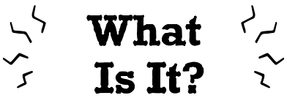
What is V-Model??
It is verification and validation.
Each phase must be completed before the next phase.
Testing is planned in parallel with a corresponding phase of development

Slide 4

Features of the V-Model
Process executes in sequential manner in V-shape
Easy and simple approach
Product definition is stable.
Well understood by team

Slide 5
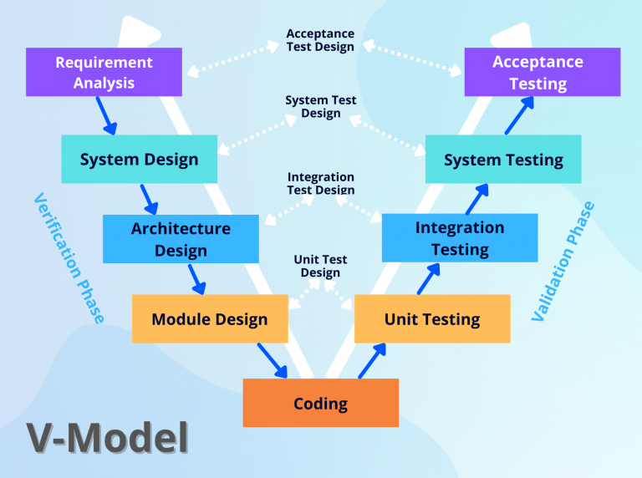
Phases of V-model
Verification Phase
Static analysis method (review)
Validation Phase
Dynamic analysis method(functional, nonfunctional)

Slide 6

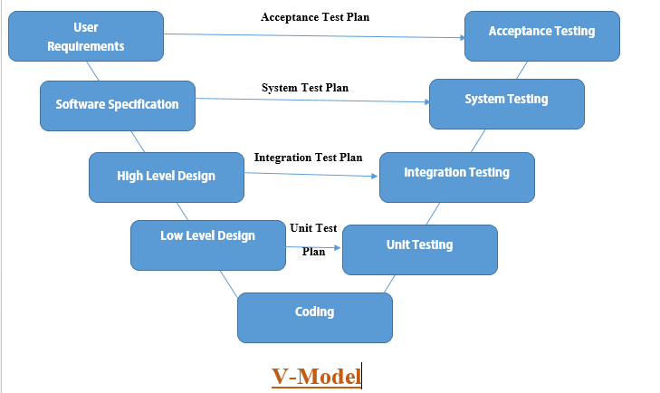
How V-model works??

Slide 7


Advantages of V-Model
Easy to understand
Avoids defects/saves time
Avoids the downward flow of the defects
Works well for small plans

Slide 8


Disadvantages of V-Model
Lacks flexibility
Not suitable for those projects where requirements are at a moderate to high risk of changing
In case of changes, both test and requirements document has to be updated.

Slide 9


Conclusions/ Takeaways/Implementations
We can implement this model when the project is short.
This model fits where requirement are well defined, clearly documented and fixed.
This model is suitable when product is stable and complete.
This model is used when the technology is not dynamic / parallel understanding by development and testing team.

Slide 10


Slide 11


